Slide 1
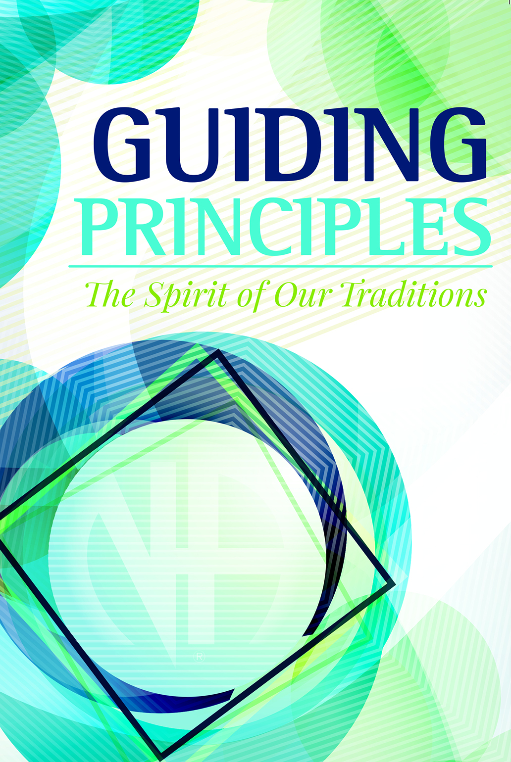
Putting Our
New Traditions Workbook
to Work
Tejas bluebonnet Region
Facilitators : Dennis R. (RD)
Brandon C. (RDA)
Notes:
The 2016 World Service Conference overwhelmingly approved our new Traditions workbook, Guiding Principles: The Spirit of Our Traditions. Our hope is that this new resource will improve the understanding and application of the Twelve Traditions throughout Narcotics Anonymous as members study ways to practice these principles in their personal lives and recovery, in NA groups, and in service to NA at all levels. This workshop is designed to introduce members to this new piece of literature and provide an opportunity to participate in the sort of discussion the book aims to inspire.

Slide 2
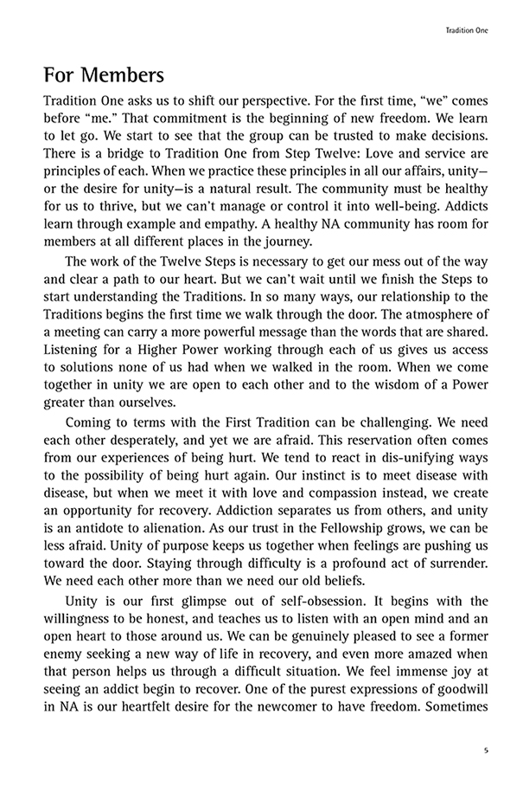
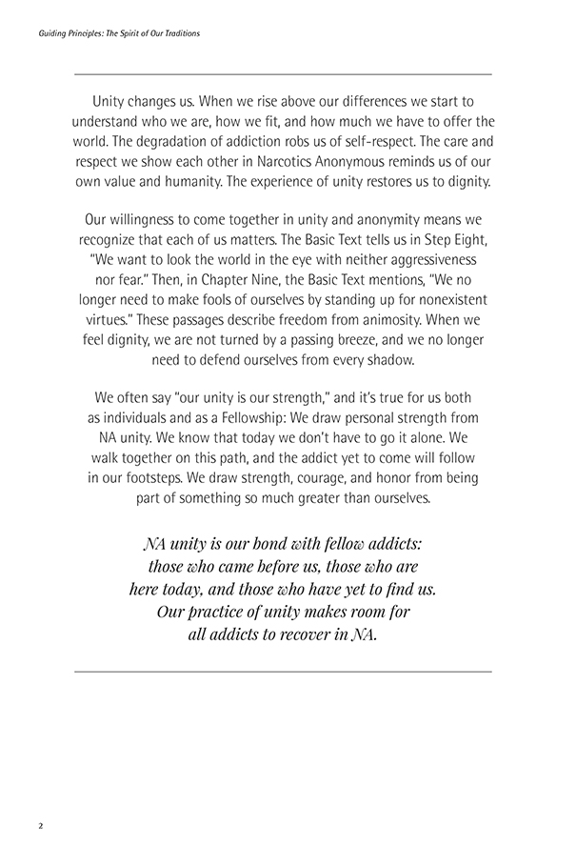
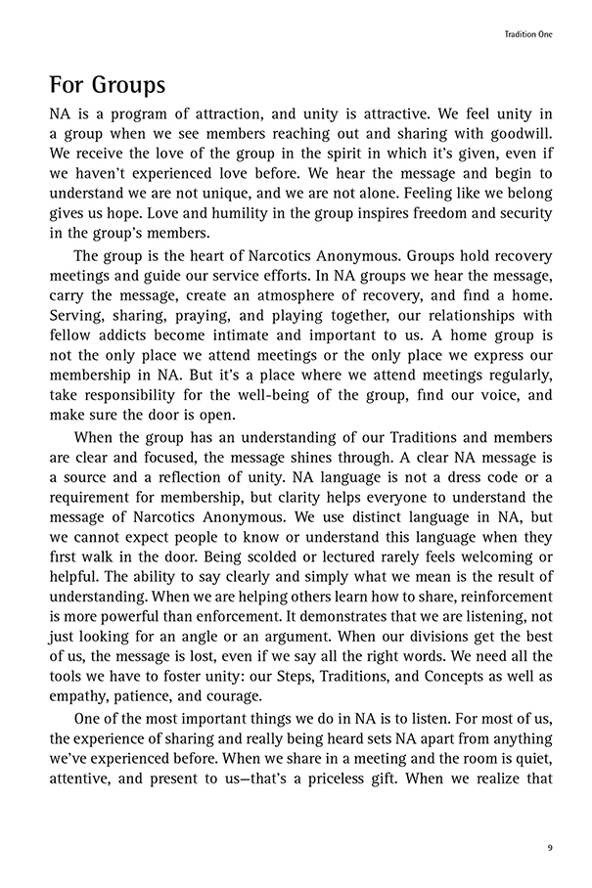
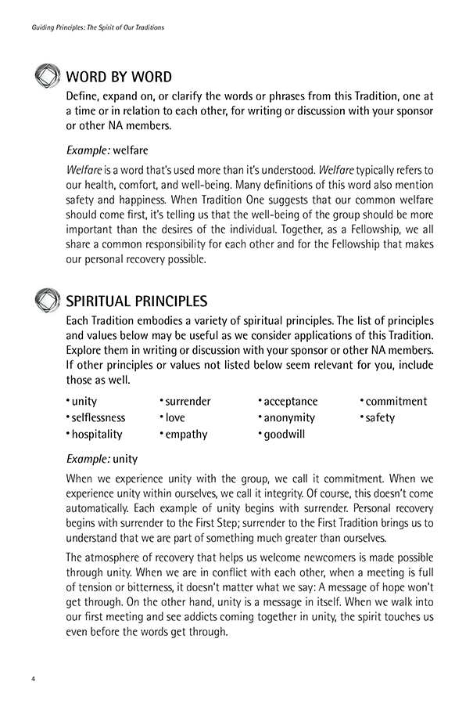
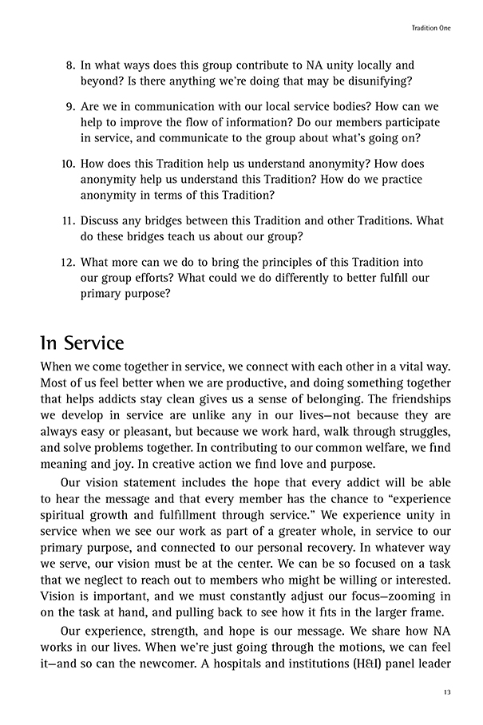
Each chapter contains
introduction
introductory
exercises
main sections
Notes:
The Traditions workbook has pieces and parts designed to work together or separately
Each chapter…
Begins and ends with short readings on one Tradition
Includes two introductory exercises:
Word by Word encourages a focused look at words and phrases that make up each Tradition.
Spiritual Principles invites us to explore some of the principles associated with each Tradition in writing or discussion.
Contains three main sections, each applying a Tradition to a different area of our lives in recovery:
“For Members” includes an essay on the applications of a Tradition to our personal recovery, followed by questions suitable for writing or discussion.
“For Groups” essays will be most relevant for groups as they seek to understand and apply the Traditions. It includes questions that may be useful for a group inventory.
“In Service” sections look at the Tradition from the perspective of service bodies. The questions in this section are intended to prompt discussion in service workshops.

Slide 3
Each group has but one primary purpose— to carry the message to the addict who still suffers.
5
Each Tradition embodies a variety of spiritual principles. The list of principles and values below may be useful as we consider applications of this Tradition. Explore them in writing or discussion with your sponsor or other NA members. If other principles or values not listed below seem relevant for you, include those as well.
integrity responsibility unity anonymity commitment
empathy service purpose open-mindedness surrender
fidelity consistency vigilance passion compassion
security hope
Example: consistency
Consistency is a spiritual principle that keeps us doing what we do. It begins with the refrain, “Keep coming back!” Coming to meetings regularly helps us stay clean, and it also carries a message of hope: We keep coming back because it works. The group depends on its members, and members depend on the group being true to its purpose. Showing up consistently, sharing honestly, and treating others with respect all further our primary purpose. A consistent message is powerful. When our actions and message are clear and consistent, our groups cannot fail.

Slide 4
How do these apply to service?
integrity responsibility
unity anonymity
commitment empathy
service purpose
open-mindedness surrender
fidelity consistency
vigilance passion
compassion security
hope

Slide 5
Small Group Discussion
1. As a member, what is the message that I carry? What does it mean to me to carry a clear NA message?
2. Discuss any bridges between this Tradition and one or more of the Twelve Concepts. What do the bridges teach us about our groups?
3. How do we bring our primary purpose into all of our service efforts?

Slide 6
LARGE GROUP DISCUSSION
QUESTION # 1: As a member
QUESTION # 2: As a Group
QUESTION # 3 : As a Service Structure

Slide 7
Guiding Principles: Putting Our New Traditions Workbook to Work
Put on a workshop locally
Send your input to wb@na.org
Get outlines and PowerPoints for this and other workshops www.na.org/IDT

