Slide 1
Overcoming
APATHY
By
Using Our Resources
Fulfilling our Primary Purpose in Challenging Times
Facilitators
Tim C. RD, Jim B. RD-A, Volunteer Region
Notes:
We are facing an epidemic of involvement in our Fellowships services. The desire to be a part of and be of service is no longer believed to be synonymous, but separate. As our Fellowship grows in numbers never before believed to be possible our members stepping into service are dwindling almost in inverse proportion. At the same time our members of long term service are being pushed out to pasture in the spirit of rotation. How can we look at these 2 items as being linked and possibly find a solution jointly.

Slide 2


Identifying The Problem
What IS Apathy??
-A state of Apathy?
  -Causes
  -Impact
  -Solutions
Apathy- apəTHē or Ap Ah Thi
Lack of interest, enthusiam, or concern
From 17th Century French apathie via Latin from Greek apatheia. Apathes-without feeling= a ‘without’ pathos ‘suffering’
Notes:
What IS Apathy. How is it impacting our Fellowship, its growth its attraction, its primary purpose!

Slide 3
Causes
How are people coming to NA now?
How do we ‘teach’ Fellowship mindset, CAN it be taught?
Is it the newest generation coming in or previous generations fatiguing?
Other factors influencing? Conventions/Events?
Notes:
Statistics show organized treatment feed us 95% of our new members.
How can we impact this mindset in Treatment? PR Solutions?
How can we TEACH a way of thinking, actions teach thoughts, how are we acting?
New members the apex or old timers?

Slide 4
Impact
What effect is Apathy having on our Fellowship?
-Services, Home Group, Area, Sub-Committees, Areas, Regions
Twelve Step Calls
IS the light dimming at the end of the tunnel or is our old way of thinking dying?
Reboot or Rethink?
Anti-NAWS Movement resources…really.
Notes:
Approximately 100% of the respondents indicated they did not have all service commitments filled at Group level, Area Level or Regional level.
The average home group has 5 members. Almost NO Areas have alternates for Admin positions.
12 Step calls have evolved into interactive Facetime calls and trying to figure out where they are going to take someone to treatment.
Even the Counter Culture Anti-NAWS folks indicate they don’t have nearly enough people involved.

Slide 5
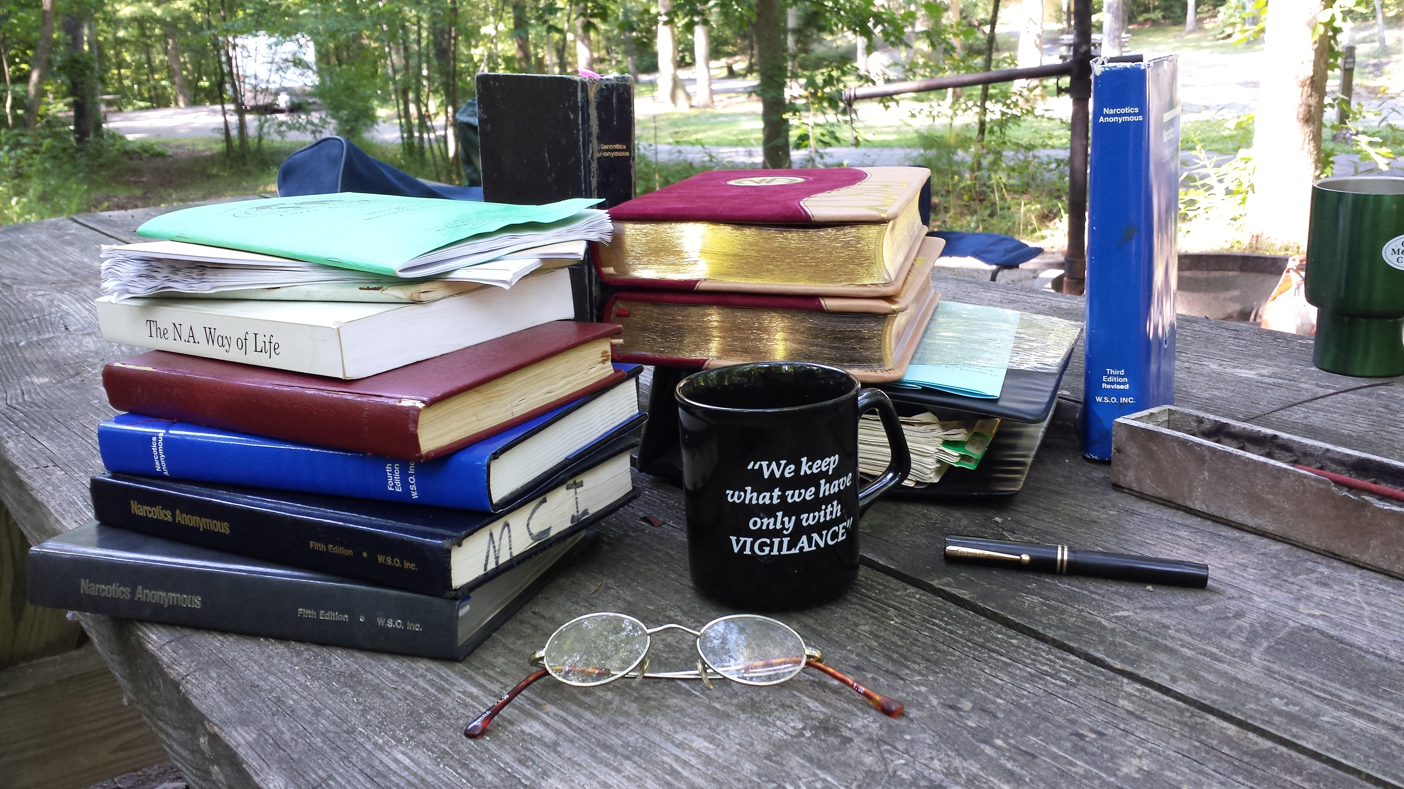
Resources
The ‘Spirit’ of Rotation
Out to pasture?
WSC HRP
Why only at the Bottom?
Shoveling sand against the tide?
By Addicts, About Addicts, For Addicts
Notes:
In many service bodies trusted servants need to rotate around because of the lack of participation.
It is a paradox, no one is willing to do the job, yet members criticize the few members who do.
Many service bodies have an informal HRP…’Oh, so and so has experience with that…”
Fighting a losing battle? Should it be allowed to fall apart? Do we do more harm than good?

Slide 6

Spiritually Minded
‘The Spiritual Part of Our disease is our total Self Centeredness’. (Basic Text, Pg 20)
Are we fighting ‘Gods Will’, should we let it fall apart and build what evolves from the rubble?
Does our internal structure serve the needs of the Fellowship or are we forcing an old system onto the next Generation?

Slide 7
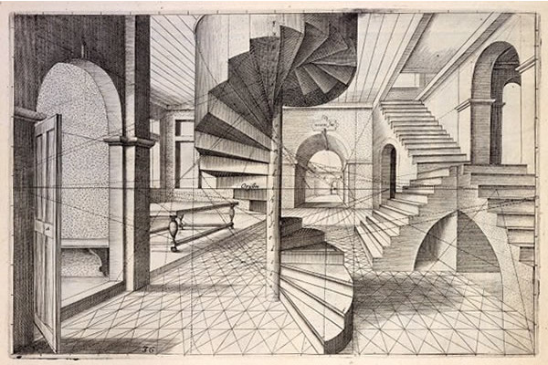
Perspective
70%-80% of AA’s budget still comes from 7th Tradition Donation
Their ‘Big Book’ is still $8.
They are promoting a concept of ‘Inspired Leadership’ within their services.
Meetings vs Groups
Comparatively their structure has more candidates the closer to the center of their structure they get, Local, District, Area, World.
Average 7th tradition per group member is $5.25
The ‘Groups’ responsibility to maintain a culture of recovery.
Localized events, Chili Cookoff, Eating Events, etc LESS CONVENTIONS
Conventions are a part of the Services, a Sub-Committee, not stand alone.
Notes:
The Parent General Assembly is what Jimmy K and Greg P derived from to establish the Tree. It stands to reason that we can reflect upon their successes and failures.

Slide 8




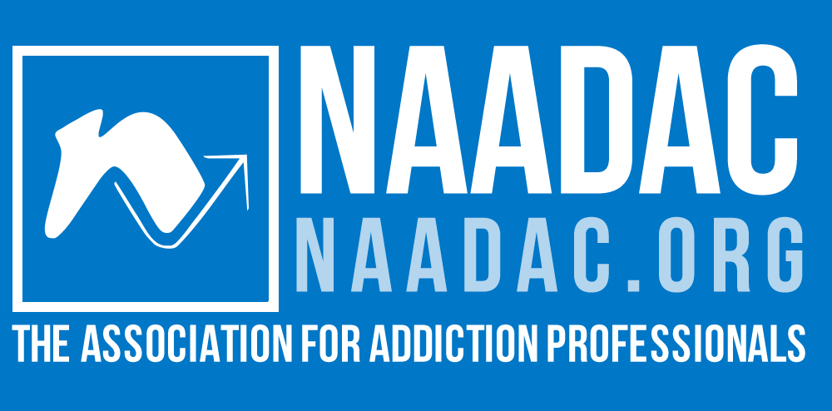
Solutions
Apathy-Where it comes from-What It Assumes
More from Problem-to-Solution
Causes into Solutions (Events a CURE???) Top Down Training more efficient that Bottom Up
Constant Contact With The Issue, No plateaus.
History, not lecturing…how we got here, the good times
Keep our eyes on the goal, the still suffering addict
Notes:
Take the information via PR to Substance Abuse and Addictions Counseling
Take the information to National Board for Certified Counselors (NBCC) or the Commission on Rehabilitation Counselor Certification (CRCC)
Tennessee substance abuse counselors are licensed by the Tennessee Board of Alcohol and Drug Abuse Counselors. Tennessee uses standards set by the Association of Addiction Professionals (NAADAC). Prospective licensees take NAADAC examinations and adhere to the NAADAC code of ethics.
Drug Treatment Court programs ‘certify’ Judges through the National Drug Court Institute or NADCP (nadcp.org). Their member Judges range in varying levels of understanding of our program, the introduction of their participants to our program and the methods by which they handle their assigned participants time with NA. A Public Relations education presentation and developing a long term relationship of providing education at the Nation level to their organization. The results will eventually have the greatest impact coming from the level of most authority within their organizarion.

Slide 9
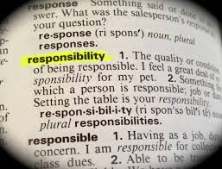


Our Resources Responsibly
History of the Human Resource Pool at WSC (Why we needed it)
Identify what rotation is? (Spirit of Law vs Letter of Law) (Policy vs Guidelines) Don’t Want To Tie God’s Hands
Attraction vs Promotion, IS PROMOTION OK??

Slide 10

Conclusions & Moving Forward
Local Resources used in Conjunction With Other Corresponding Resource The PR Message at the Local Level needs to be Identical to the PR message that the PR committee presents at National Associations.
A VISION-Identify the goal, not just the problem.
Missed opportunities, schools and VoTec What about positive organizations? Boy/Girl Scouts, 4H, ROTC, Young Leaders.
A concept of ‘Inspired Leadership’ to strongly encourage service.

